Slide 1
Characters Behaviors in Video game Using Reinforcement Learning
Surachet Yaitammasan 59070180
Akarapon Akarasuri 59070189
Assist.prof.dr.Samart Moodleah
Assist.prof.dr.supannada chotipant

Slide 2
1
Our work
5
Deep Reinforcement Learning
2
Reinforcement Learning?
6
Process
3
Tool
Result
7
4
Reinforcement Learning Algorithm
Conclusion
8
8

Slide 3
Our
Work

Slide 4
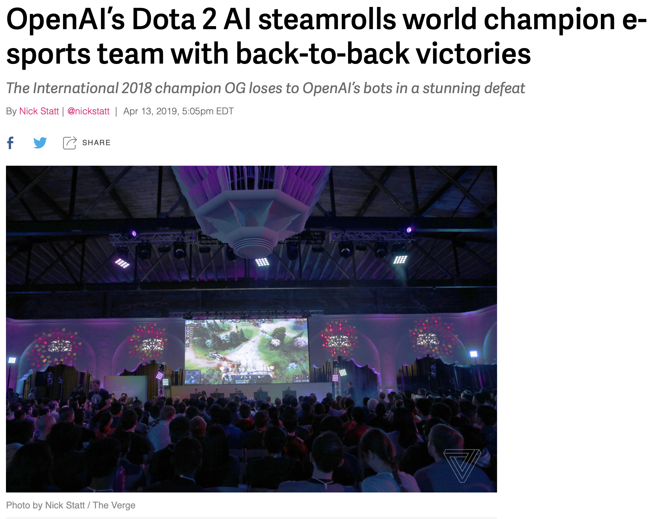
Today video game industry became increasingly popular and growing up. Video game was create for teaching, training skill or world championships. Start making AI (Artificial Intelligence) has been used in video game. We are inspired to research from OpenAI Five is AI can win world champion team Dota 2. We need to make AI for playing video game but we don’t know which method is the most effective for AI. So we making this research.
resource: https://www.theverge.com/2019/4/13/18309459/openai-five-dota-2-finals-ai-bot-competition-og-e-sports-the-international-champion
Apr 13, 2019

Slide 5
Reinforcement
Learning?

Slide 6
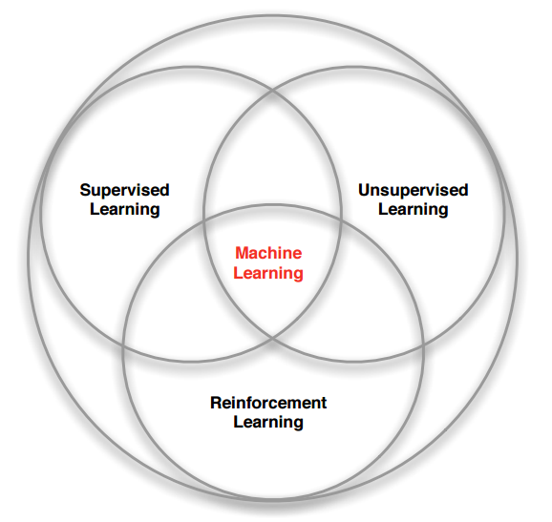
Reinforcement Learning (RL) is a one part of Machine Learning that about Trial-and-Error
That Inspire by concept of Behavioral Psychology

Slide 7
Cycle

Slide 8
Give me a hand. Good!
Give me hand. Ouch!!!!
Reward (Positive Reward)
Punishment (Negative Reward)

Slide 9

Quiz
Time!
Simulation IT Quiz
There are 10 questions. Student doing quiz if student answer is correct they will score 1 point but they answer is wrong them will score 0

Slide 10
Tools

Slide 11
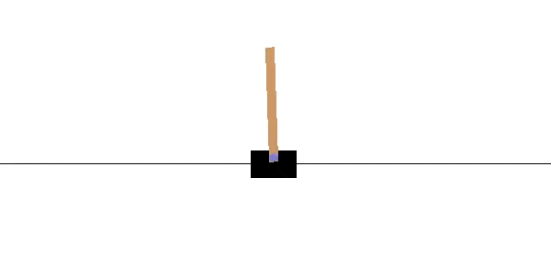
Gym : toolkit for developing and comparing reinforcement learning algorithms

Slide 12
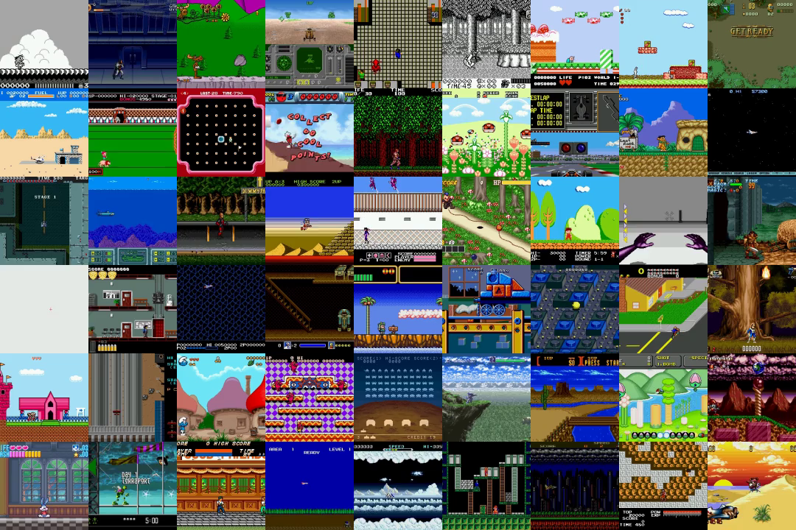
Gym Retro: turns classic video games into Gym environments for reinforcement learning

Slide 13

TensorFlow:
end-to-end open source platform for machine learning
W

Slide 14
Reinforcement Learning Algorithms

Slide 15
Reinforcement Learning Algorithms
Valued-Based Algorithms
Q-Learning
Deep Q-Network
Double DQN
Policy-Based Algorithms
Asynchronous Advantage Actor-Critic (A3C/A2C)
Proximal Policy Optimization (PPO)
Deep Deterministic Policy Gradient
Twin Delayed DDPG
And many more …

Slide 16
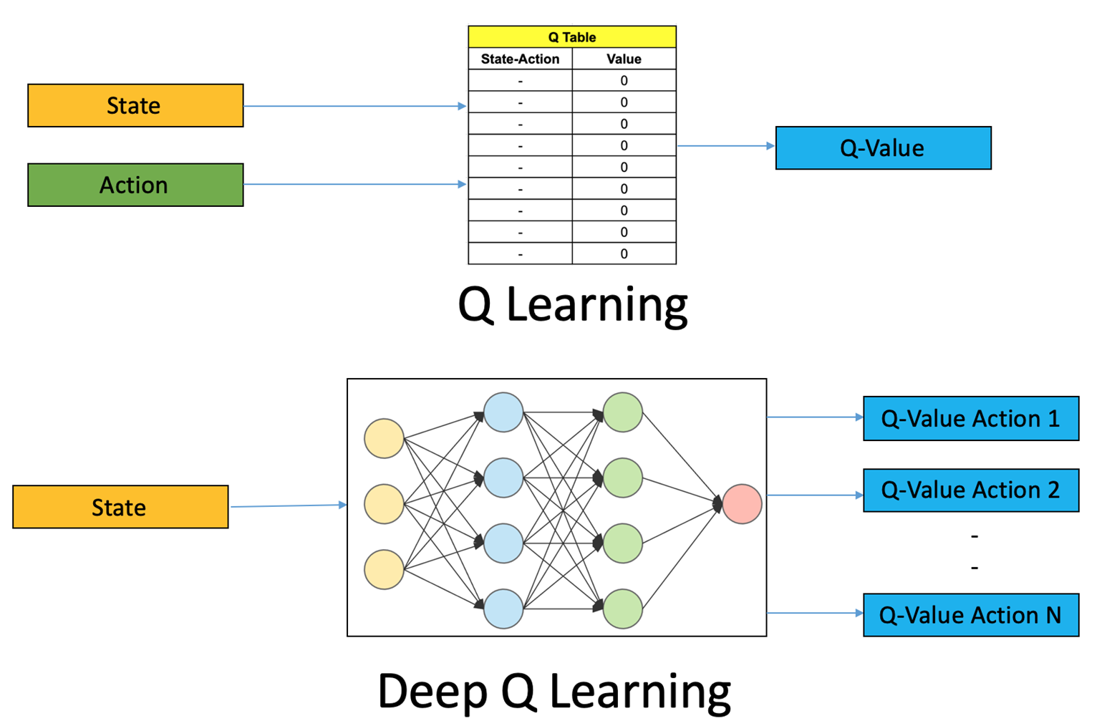
Q-Learning
Q-Learning is an algorithm that uses Q-Values to use for selecting actions in that situation. Which actions give the best results in the situation In order to receive the best award of the specified environment By selecting the best action in that situation, pass the Q-Value value in the Q-Table with the magnitude of the action multiplied by all possible situations.

Slide 17
Deep Q-Learning
Deep-Q-Learning Is a combination of Reinforcement learning with neural networks serves to estimate the Q-value of actions that can be performed. Instead of using calculations from the Bellman's equation in Q-Table, because the situation within the environment is so large that the method cannot be used Q-learning. For example playing video games There are a lot of things that can happen. Therefore use the neural network to find the best action to solve that problem

Slide 18
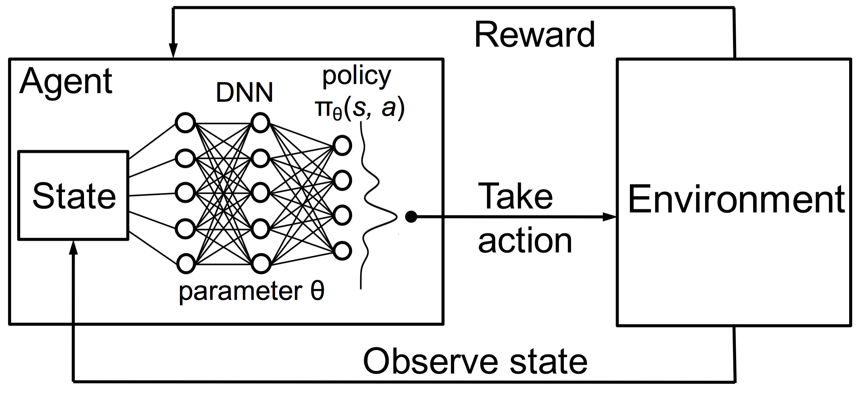

Slide 19
Process

Slide 20
Overall Process
Select Environment
Preprocess
Training
Get Model for Testing
Plotting Graph

Slide 21
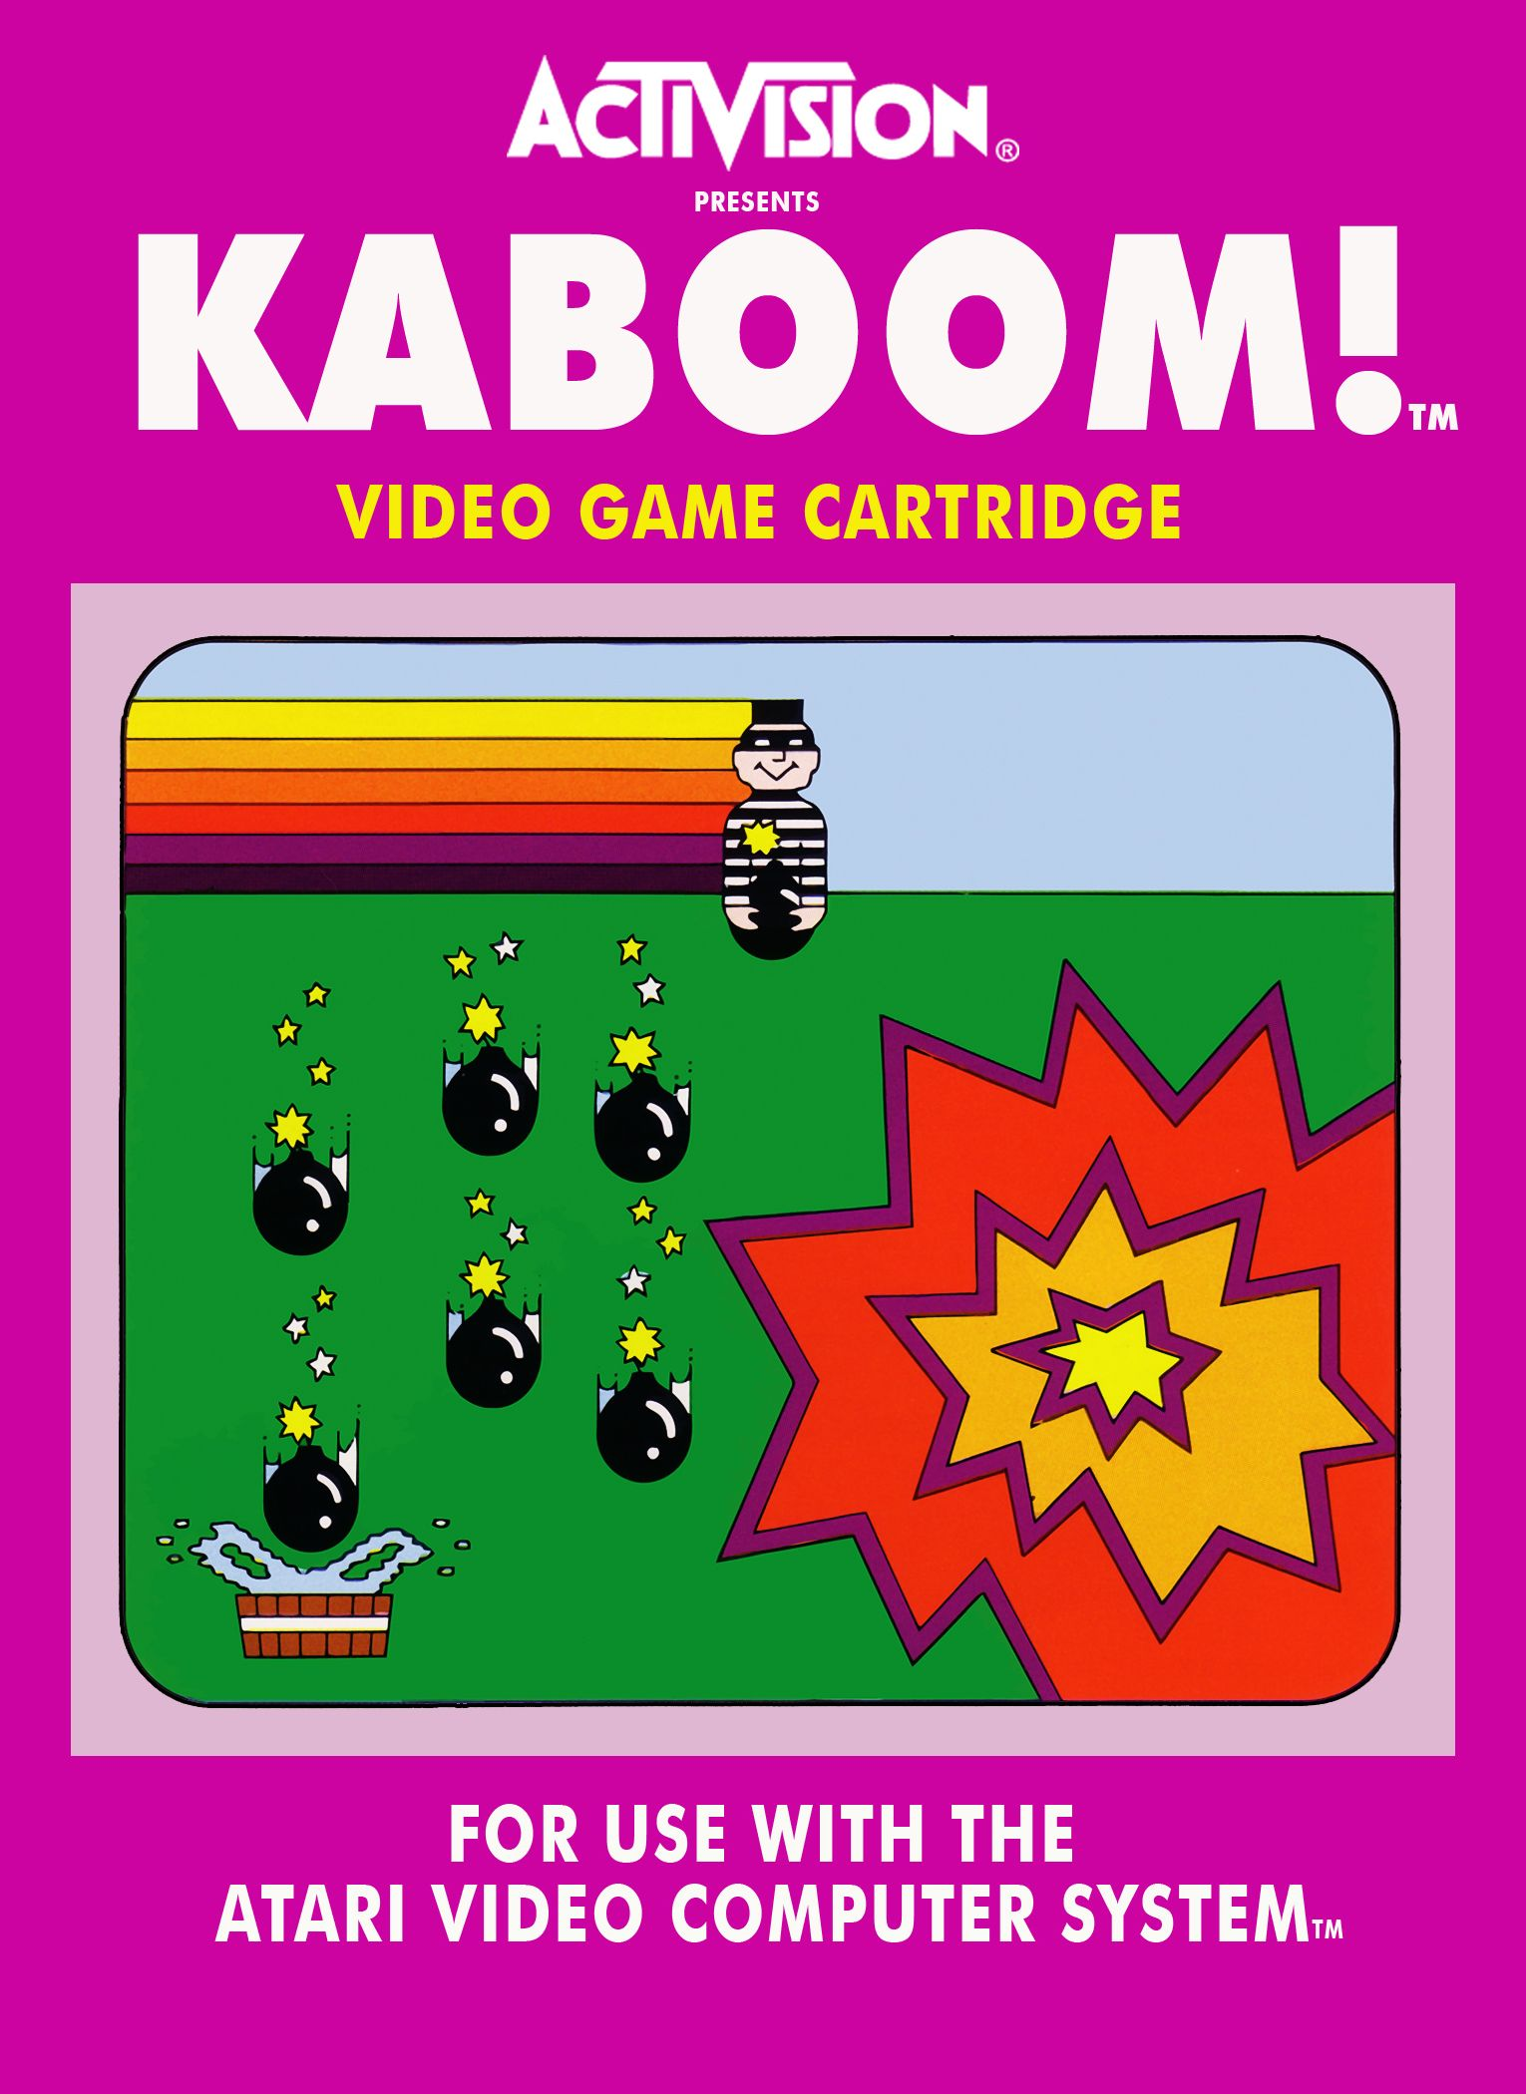
Environments
Game : Kaboom
Platform : Atari 2600
Genre : Action
Player(s) : 1 player
Developer : Larry Kaplan
Publisher : Activision
Objective : Received a bomb to get score
Rom File : Kaboom! (Paddle) (CCE).bin
Insert video game play

Slide 22
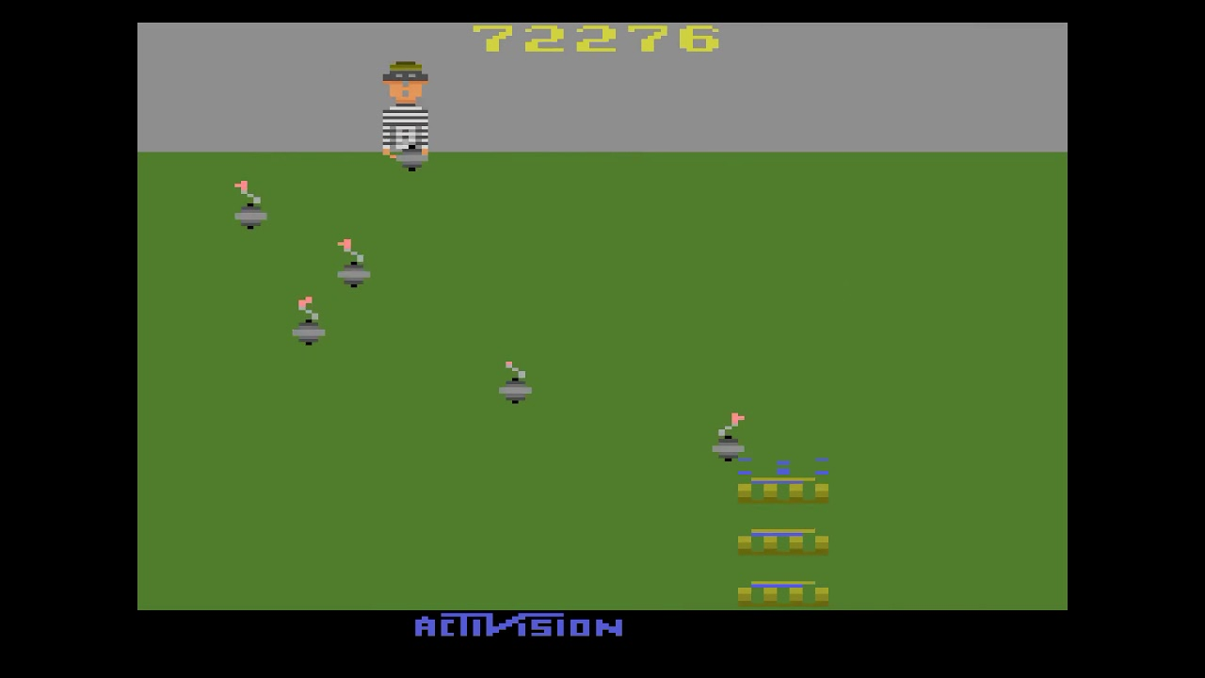
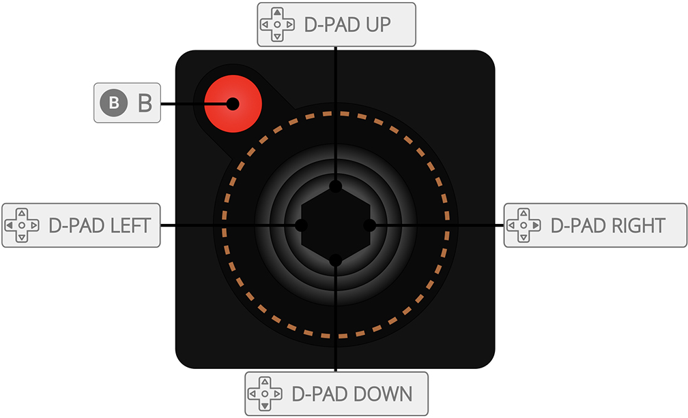
Actions
Left : Move Left
Right : Move Right
Button : Released a bomb from thief for each wave

Slide 23
Goals
Received bombs as much as possible
to get High Score, If miss lose 1 life.
If life to 0. Game Over

Slide 24
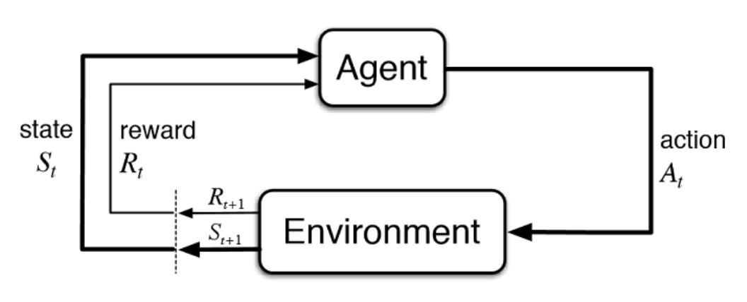
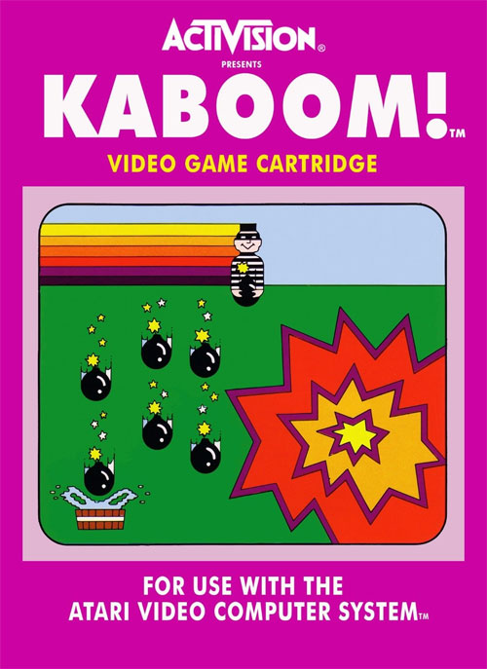
Kaboom Reinforcement Learning Cycle
State : Each Frame of Game
Action
Left, Right, Button
Environment
Kaboom Atari 2600 game
Positive Reward : if player catch a bomb. Get scores
Negative Reward : If player miss catching. Lose 1 Life

Slide 25
Environment Details
Observation Spaces : State of Agent’s Received
Observation Type : Box (Frame)
Observation Size : 210 x 160 x 3(Width x Height x Color Channel)

Slide 26
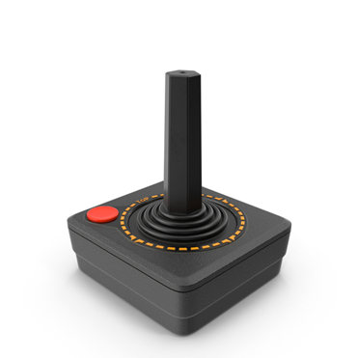
Environment Details
Action Spaces : A possible actions can do in environments
Action Type : MultiDiscrete (Only one button can be Press)
Action Size : 8
Actions : BUTTON , SELECT, null, RESET, UP, DOWN, LEFT, RIGHT

Slide 27
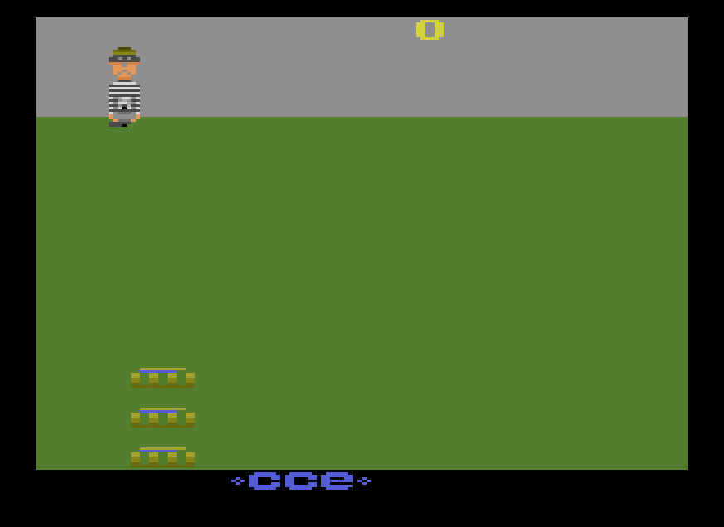
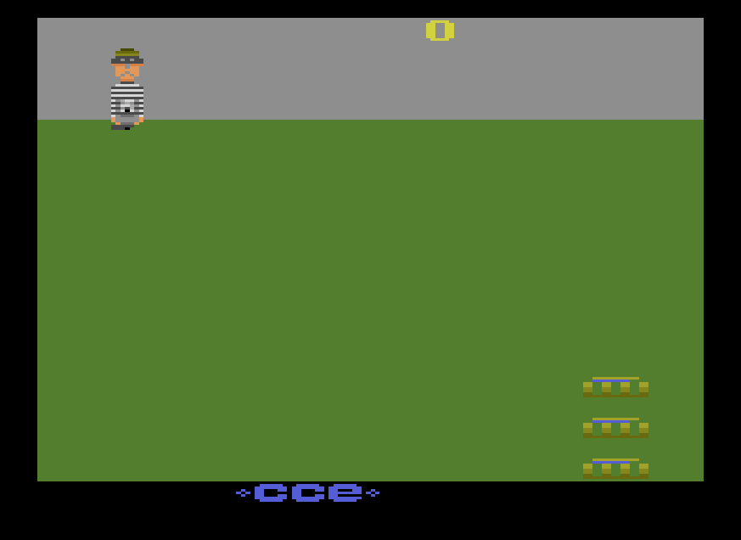
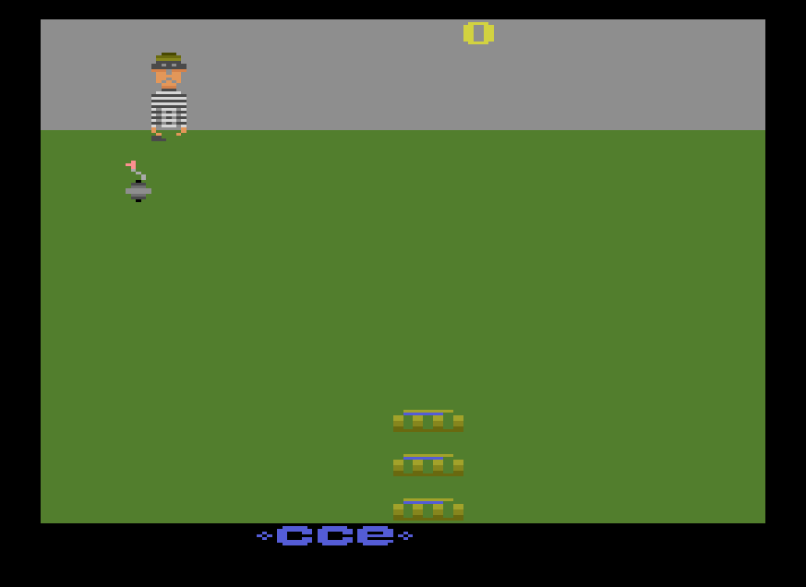
Restrict actions for Kaboom Environment
Every time that make Environment from gym-retro library action spaces depened on
Game platform so we pick some actions are properly for an environment
Left : Move Left
Right : Move Right
Button : Drop Bombs

Slide 28
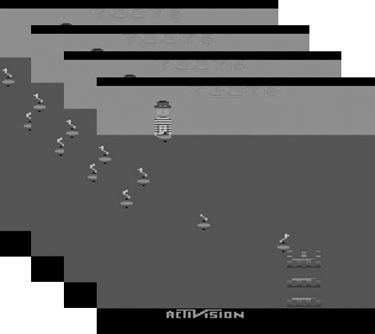
Simplified structure for CNN process
Q-Value 1 (Left)
Convolutional neural network
Q-Value 1 (Right)
Q-Value 1 (Button)
State

Slide 29
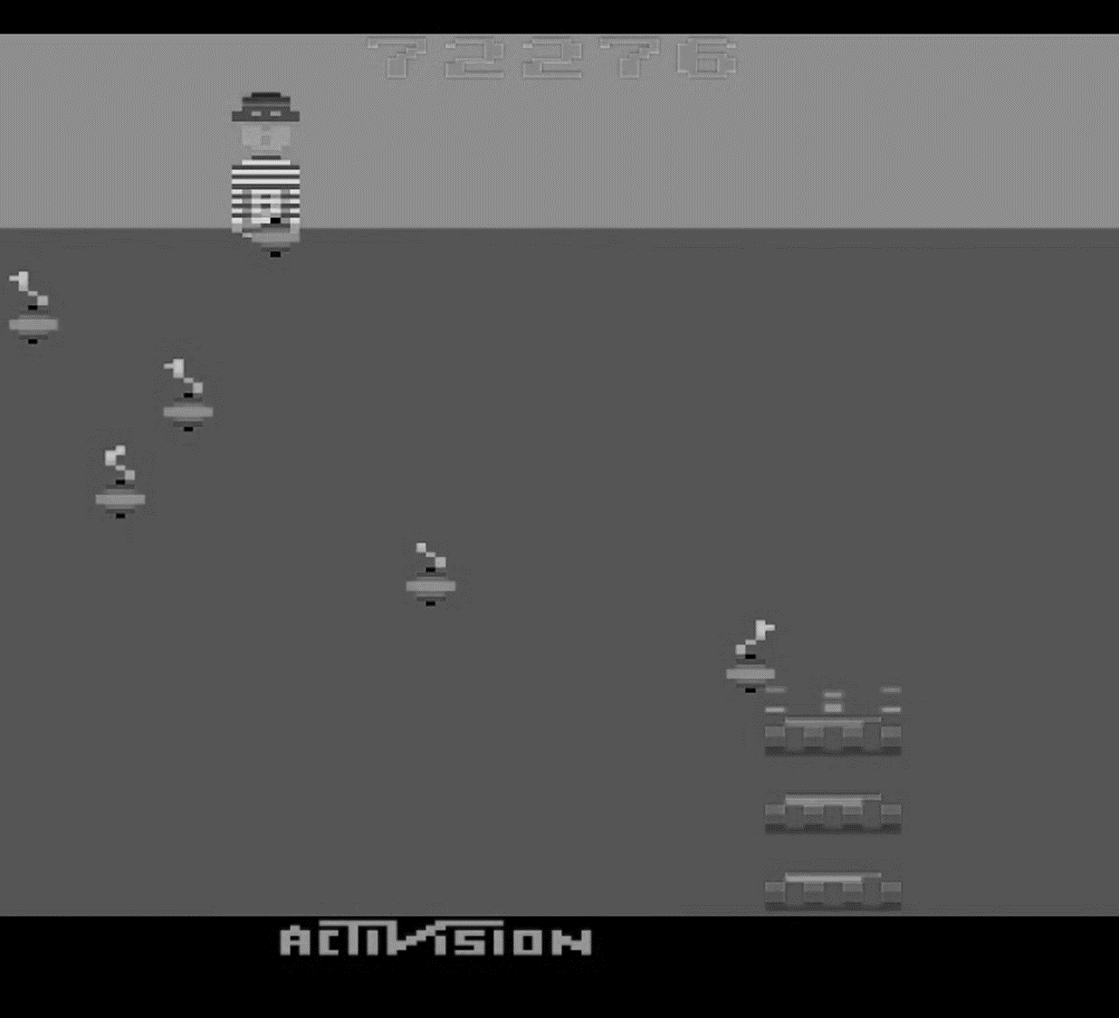

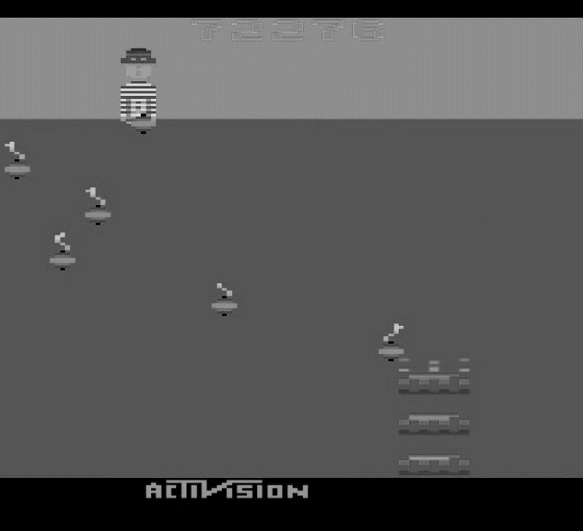
Frame Preprocessing
Frame Size : 210x160
Frame Size : 84x84
Turn to Grayscale
Stack to 4 frames each step

Slide 30
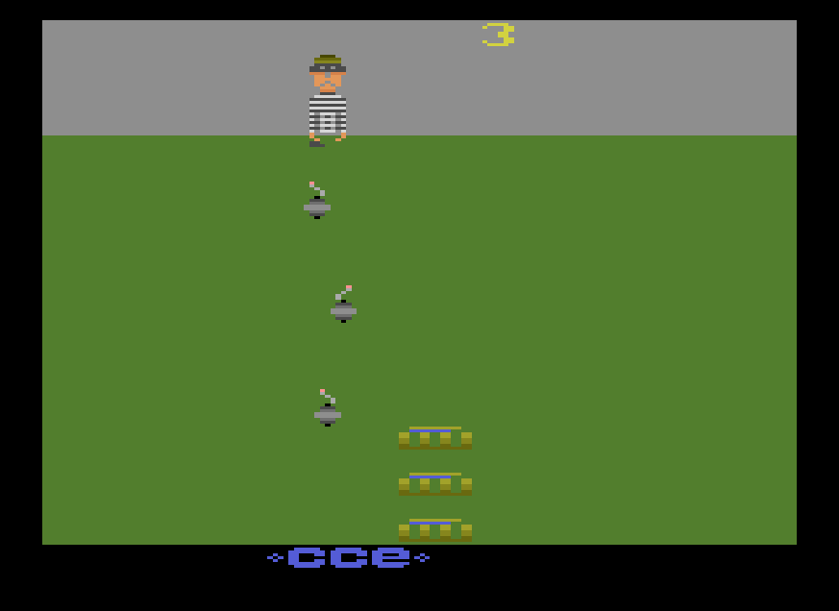
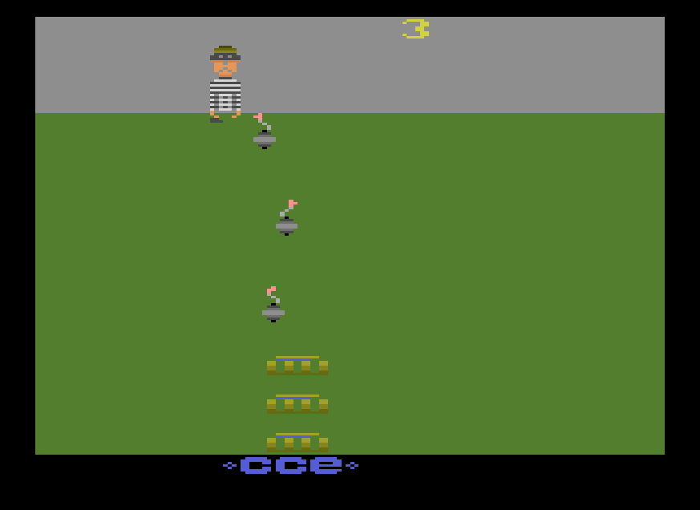
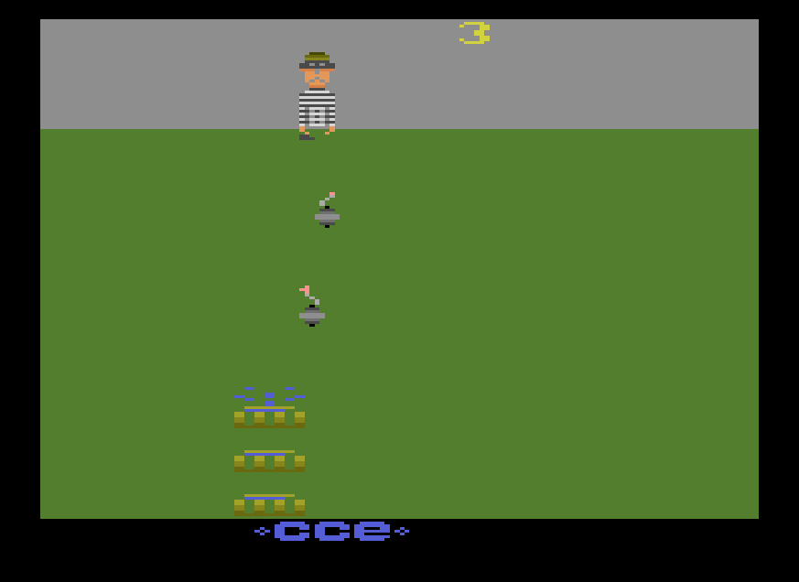
Why Stacking Frame?
If use one frame for each step. Agent not know what happened before. Use frame stack to make an Agent know what happened before
Current Frame
1st Previous Frame
2nd Previous Frame

Slide 31
Convolutional Neural Network Structure
Conv2D
32, 8
strides=(4,4)
Padding=“valid”
activation=“relu”
input_shape=84x84x4
data_format=“channels_first”
Conv2D
64, 4
strides=(2,2)
Padding=“valid”
activation=“relu”
input_shape=84x84x4
data_format=“channels_first”
Input
Q-Value1 (Right)
Conv2D
64, 3
strides=(1,1)
Padding=“valid”
activation=“relu”
input_shape=84x84x4
data_format=“channels_first”
Q-Value1 (Left)
Dense(3)
Dense(512)
Flatten
Q-Value1 (Button)

Slide 32
Double Deep-Q-Network (DDQN)
Is a upgrade version of Deep-Q-Network to fix a problem of DQN is Q-Values are overestimated that makes Agent not Find a new ways to get a optimal way to achieved objective
The way is decoupled to two separated network called “Primary Network” and “Target Network”. Use primary Network to select an action and target Network calculate a Q-Value for that action
Copy weight from primary network to target network every n training steps to synchronized networks
Insert image

Slide 33
Result

Slide 34
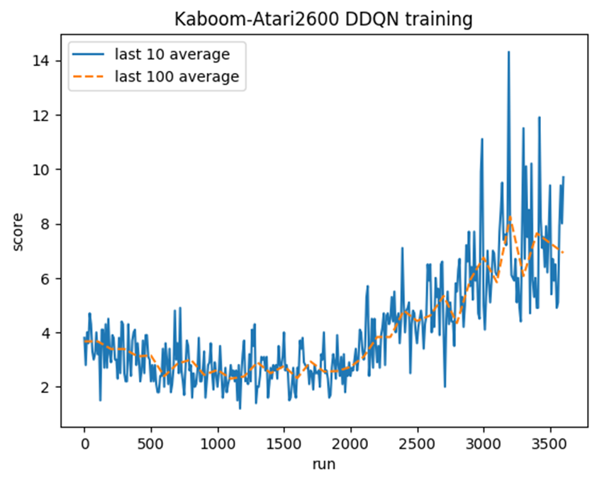
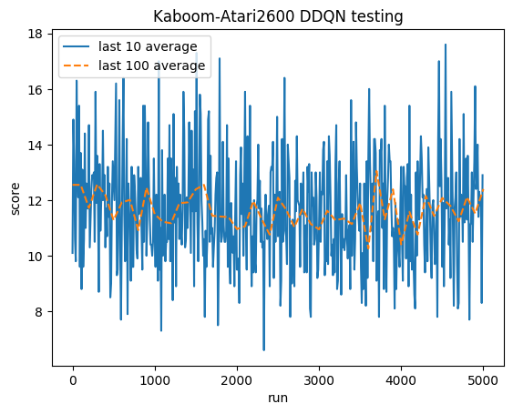
Training 3600 Episode
Testing 5000 Episode
Fix
Processor: 2.3 GHz Quad-Core Intel Core i5
Memory: 16 GB 2133 MHz LPDDR3
Graphics: Intel Iris Plus Graphics 655 1536 MB

Slide 35
Overall process

Slide 36
Testing Results
 | Avg. score
Human | 100
1000 EP
1500 EP
2500 EP
5000 EP | 12

Slide 37
Conclusion

Slide 38
DDQN can train agent to play game effectively if spend time to training agent so long the result will be high score. In training agent we have encountered problems with devices and accident. Make note enough time.

Slide 39

Thanks for listens
and question

